Slide 1
Remote Thermostat Control
Ryan Johnson

Slide 2
Idea
Monitor and control your thermostat from anywhere
Raspberry PI connected to two push/pull solenoids, which can be controlled remotely utilizing MQTT messaging
Solenoids will be mounted such that they can push the Up and Down buttons on the thermostat
Camera mounted and pointing towards thermostat to allow user to see current temperature and see temperature changing

Slide 3
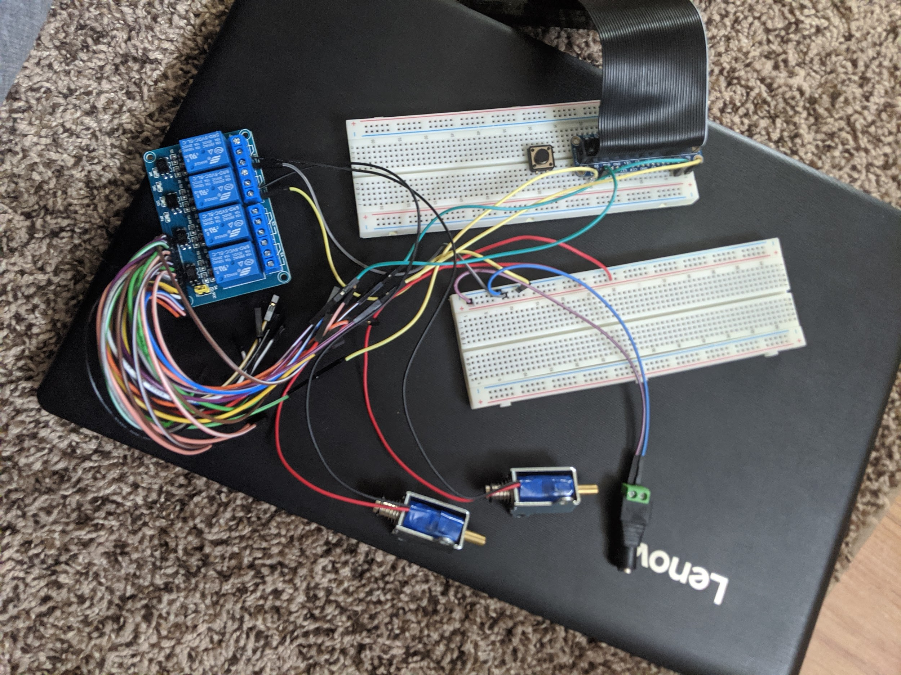
Solenoid Circuit Layout

Slide 4
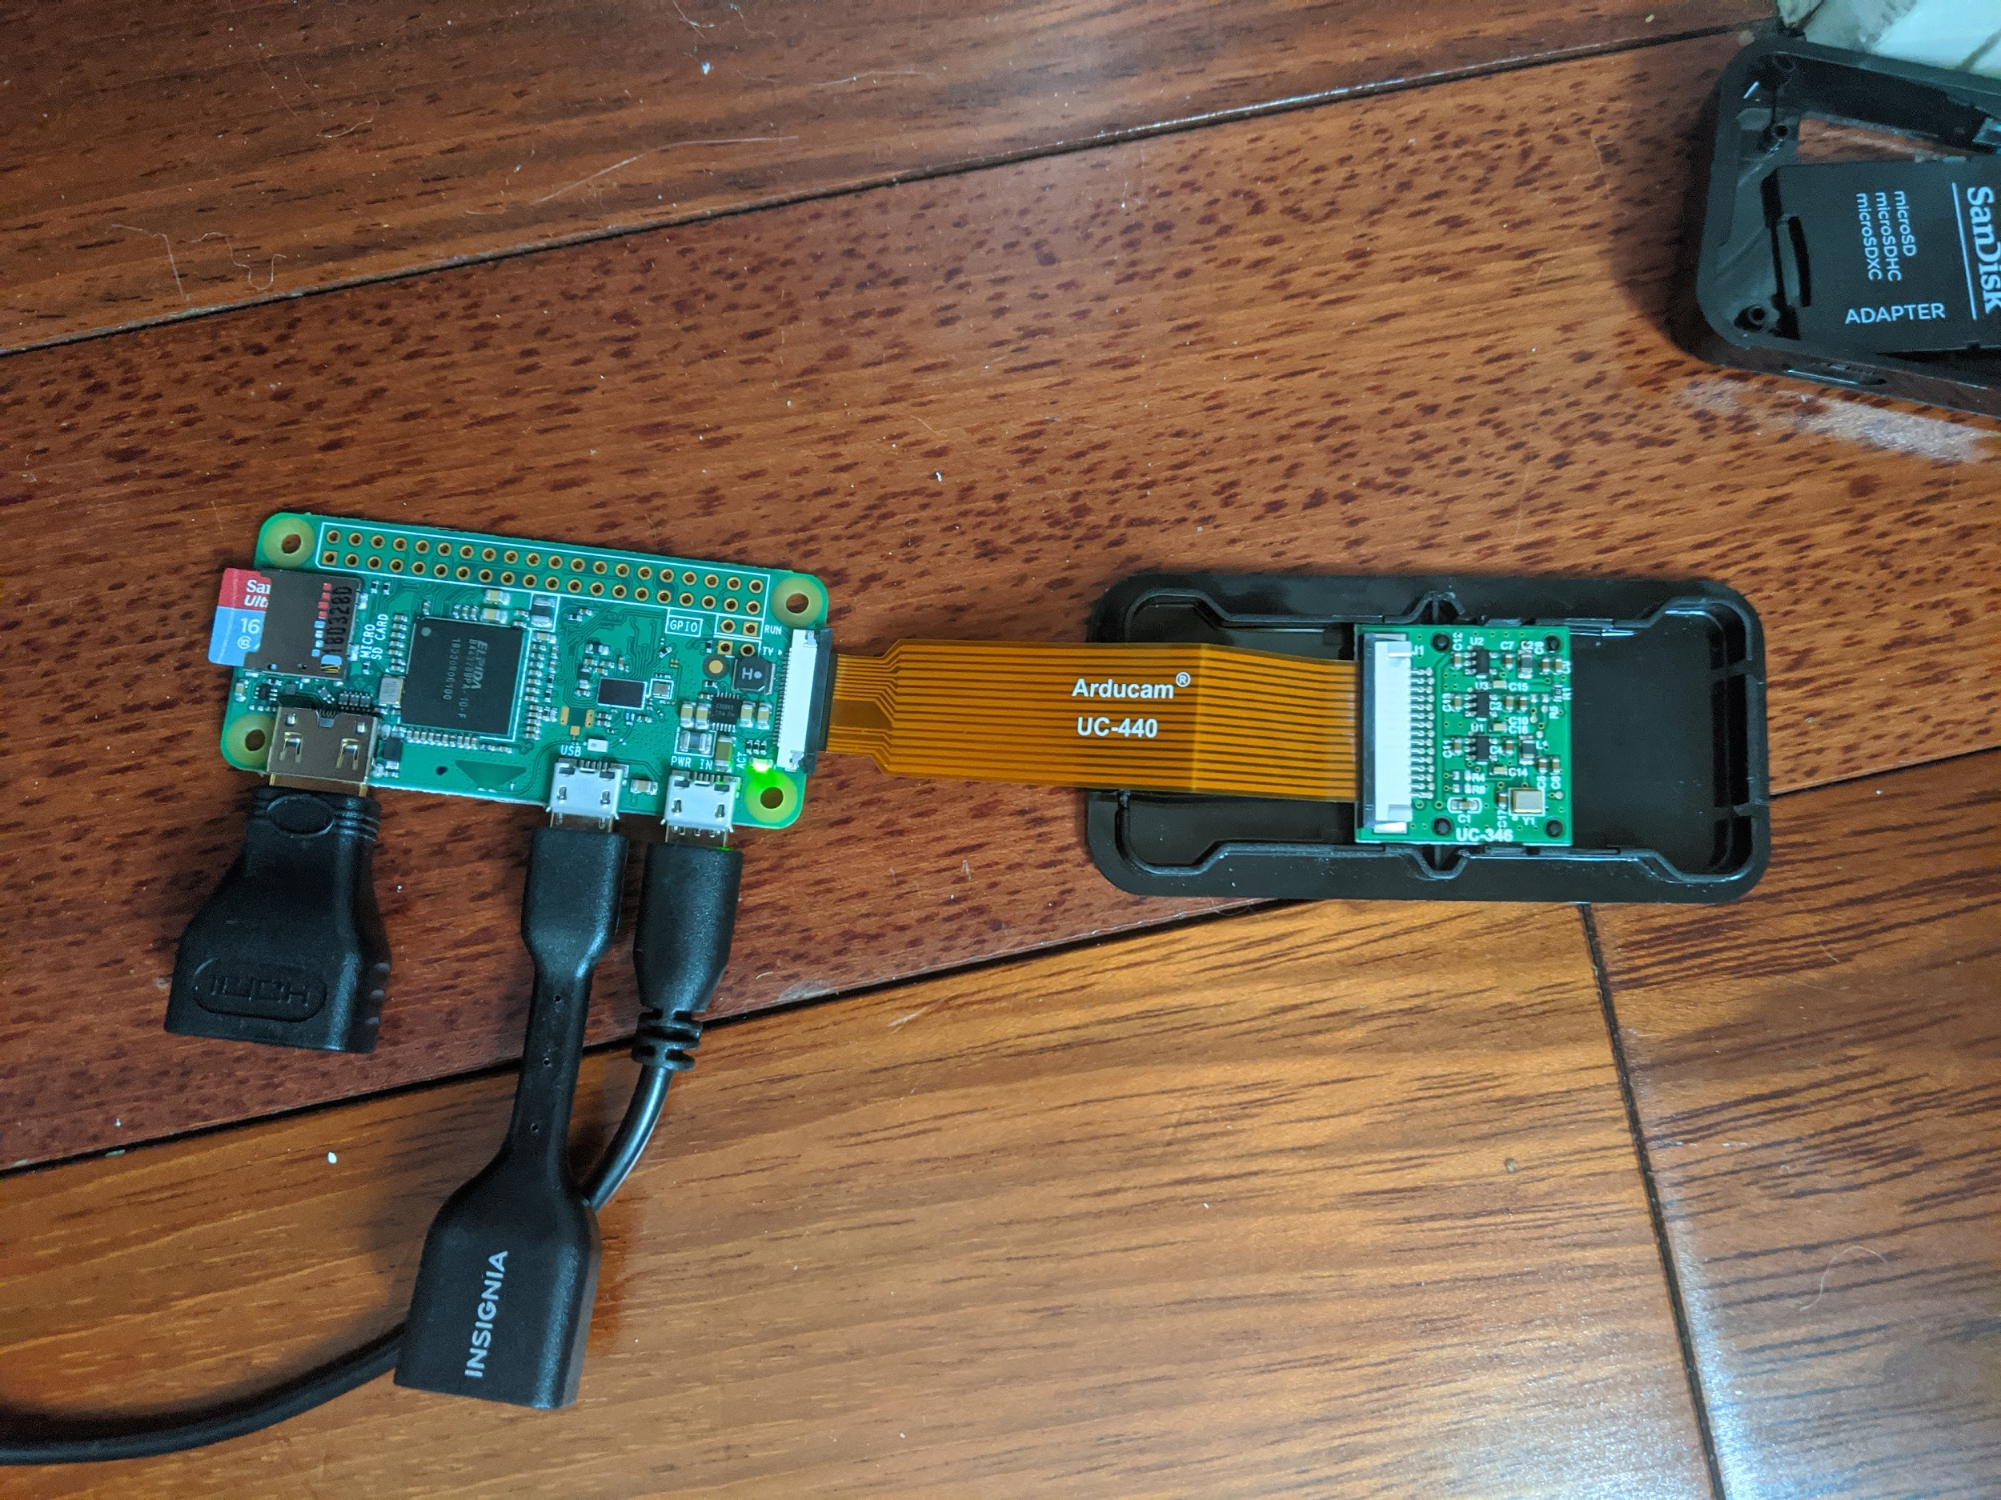
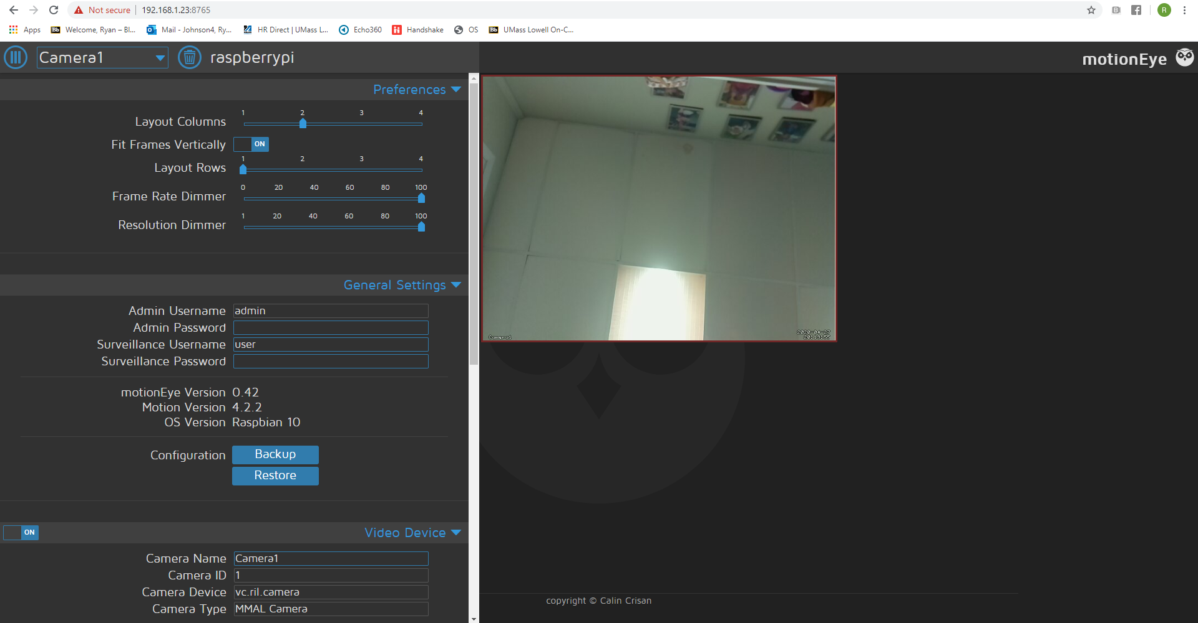
Camera
Separate Pi Zero controls camera
Motion eye OS
Streaming URL can be displayed on webpage

Slide 5
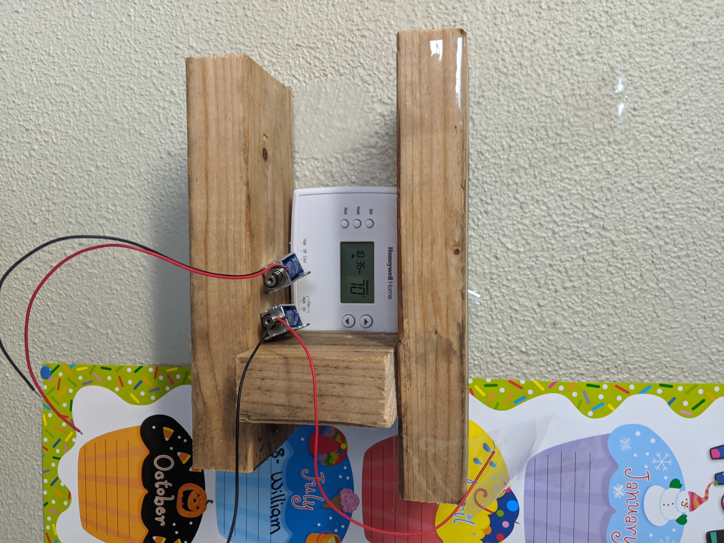
Wall Mount
Simple mount with 3 pieces of wood
Command Strips and lots of tape
Solenoids screwed in, RPi and breadboards on top

Slide 6
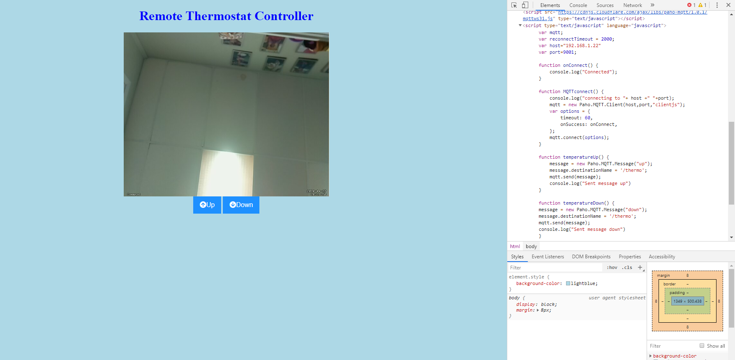
Created simple but effective user interface using HTML and Javascript that displays video stream and provides the user up and down arrows to change temperature
Webpage publishes MQTT messages using the MQTT javascript client
Streaming URL embedded in webpage

Slide 7
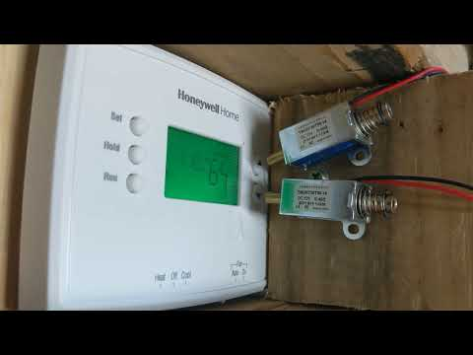

Slide 8
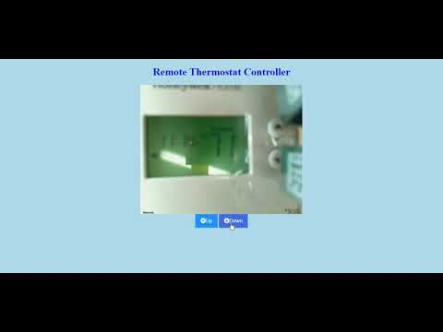

Slide 9
What I would do next...
Utilize Ngrok to make access available outside of local network
Sleeker/More compact design
More powerful solenoids to eliminate tape

Slide 10
Helpful Resources
Guide for using MQTT in Javascript code
http://www.steves-internet-guide.com/using-javascript-mqtt-client-websockets/
Daniel

